Slide 1
Basic presentation

Slide 2
Investigation topic
How does image-to-text processing affect the Bleu scores of zero-shot prompting between Spanish and Portuguese

Slide 3
effective strategies in zero-shot neural machine translation.
Thanh-Le Ha, Jan Niehues, Alexander Waibel
[PDFSemantic Scholar. (n.d.).] https://www.semanticscholar.org/reader/bc4a8e412aaabc5dbb8e4bc534870226abbf239f

Slide 4
Multimodal prompt tuning for zero-shot instruction learning. arXiv.org.
Wang, T., Liu, Y., Liang, J. C., Zhao, J., Cui, Y., Mao, Y., Nie, S., Liu, J., Feng, F., Xu, Z., Han, C., Huang, L., Wang, Q., & Liu, D. (2024, October 30). M$^2$PT: https://arxiv.org/abs/2409.15657

Slide 5
Image Parsing to Text Description
B. Z. Yao, X. Yang, L. Lin, M. W. Lee and S. -C. Zhu, "I2T: Image Parsing to Text Description," in Proceedings of the IEEE, vol. 98, no. 8, pp. 1485-1508, Aug. 2010, doi: 10.1109/JPROC.2010.2050411.

Slide 6
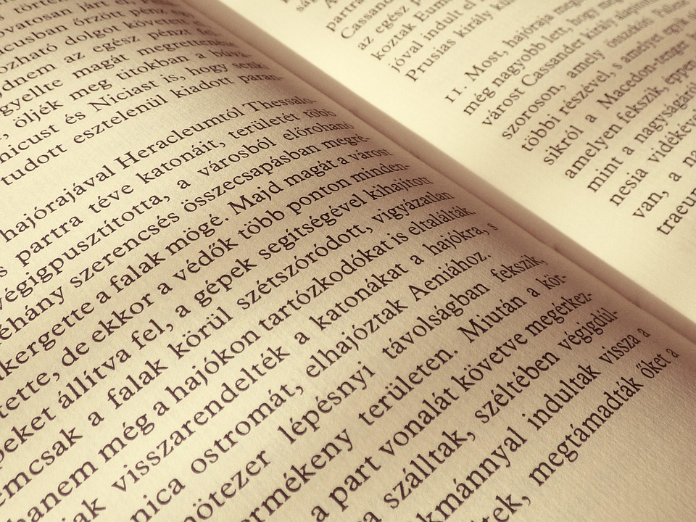
Corpora involved
English to Spanish 1.4 million lines
English to Portuguese
Spanish to Portuguese Data Found on the web via … for the testing sets

Slide 7

Code Archetecture
Integrate text recognition software with a zero-shot prompting mode
Code to integrate the training sets
Use of sentence piece
Code to align the sentences with photos and their outputs from the photo to text

Slide 8
Types of evaluation
For human evaluation, the eval couting tool will be used
Bleu and Comet

Slide 9
Expected conclusion
I expect that translation from pictures will be nearly as good as the translations that come directly from text

